Slide 1
The Deadlock Problem
A set of blocked processes each holding a resource and waiting to acquire a resource held by another process in the set
Example
System has 2 disk drives
P₁ and P₂ each hold one disk drive and each needs another one
Example <
semaphores A and B, initialized to 1
P₀ P₁
wait (A); wait(B)
wait (B); wait(A)
‹#›
Notes:
‹#›

Slide 2
Bridge Crossing Example
section1
section2
Traffic only in one direction
Each section of a bridge can be viewed as a resource
If a deadlock occurs, it can be resolved if one car backs up (preempt resources and rollback)
Several cars may have to be backed up if a deadlock occurs
Starvation is possible
Note – Most OSes do not prevent or deal with deadlocks
‹#›
Notes:
‹#›

Slide 3
System Model
Resource types R₁, R₂, . . ., R_{m}
CPU cycles, memory space, I/O devices
Each resource type R_{i} has W_{i} instances.
Each process utilizes a resource as follows:
request (may cause the process to wait)
use
release
‹#›
Notes:
‹#›

Slide 4
Deadlock Characterization
Deadlocks can arise if four conditions hold simultaneously
Mutual exclusion: only one process at a time can use a resource
Hold and wait: a process holding at least one resource is waiting to acquire additional resources held by other processes
No preemption: a resource can be released only voluntarily by the process holding it, after that process has completed its task
Circular wait: there exists a set {P₀, P₁, …,P_{N}, P₀} of waiting processes such that P₀ is waiting for a resource that is held by P₁, P₁ is waiting for a resource that is held by P₂, …, P_{n–1} is waiting for a resource that is held by P_{n}, and P_{n} is waiting for a resource that is held by P₀.
‹#›
Notes:
‹#›

Slide 5
Resource-Allocation Graph
A set of vertices V and a set of edges E.
V is partitioned into two types:
P = {P1, P2, …, Pn}, the set consisting of all the processes in the system
R = {R1, R2, …, Rm}, the set consisting of all resource types in the system
request edge – directed edge Pi → Rj
assignment edge – directed edge Rj → Pi
‹#›
Notes:
‹#›

Slide 6
Resource-Allocation Graph (Cont.)
Process
Resource Type with 4 instances
P_{i} requests instance of R_{j}
P_{i} is holding an instance of R_{j}
P_{i}
R_{j}
P_{i}
R_{j}
‹#›
Notes:
‹#›

Slide 7
Example of a Resource Allocation Graph
‹#›
Notes:
‹#›

Slide 8
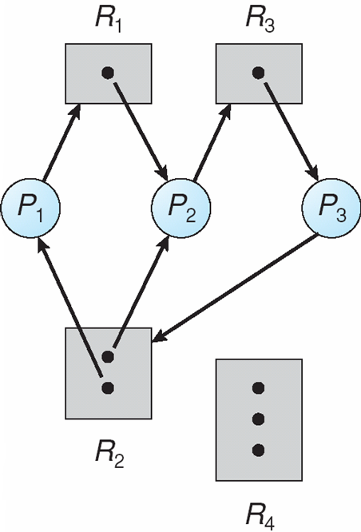
Resource Allocation Graph With A Deadlock
There is a cycle
and
Deadlock
‹#›
Notes:
‹#›

Slide 9
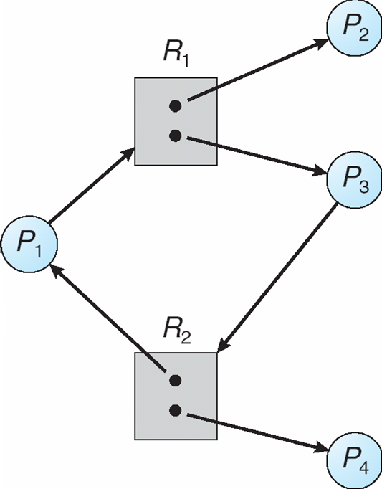
Graph With A Cycle But No Deadlock
There is a cycle
but
No Deadlock
‹#›
Notes:
‹#›

Slide 10
Basic Facts
If graph contains no cycles ⇒ no deadlock
If graph contains a cycle ⇒
if only one instance per resource type, then deadlock
if several instances per resource type, possibility of deadlock
‹#›
Notes:
‹#›

Slide 11
Methods for Handling Deadlocks
Ensure that the system will never enter a deadlock state
Deadlock Prevention or Deadlock Avoidance methods
Allow the system to enter a deadlock state and then recover
Deadlock Detection needed
Ignore the problem and pretend that deadlocks never occur in the system;
Used by most operating systems, including UNIX
OS does not bother with deadlocks that can occur in applications
‹#›
Notes:
‹#›

Slide 12
Deadlock Prevention
Basic Principle: Restrain the ways requests can be made
Mutual Exclusion – not required for sharable resources; must hold for nonsharable resources
Hold and Wait – must guarantee that whenever a process requests a resource, it does not hold any other resources
Require process to request and be allocated all its resources before it begins execution, or allow process to request resources only when the process has none
Low resource utilization; starvation possible
‹#›
Notes:
‹#›

Slide 13
Deadlock Prevention (Cont.)
No Preemption –
A processing holding resources make requests: if request cannot be granted, release (preempt) the held resources, and try again later.
Preempted resources are added to the list of resources for which the process is waiting
Process will be restarted only when it can regain its old resources, as well as the new ones that it is requesting.
Circular Wait – impose a total ordering of all resource types, and require that each process requests resources in an increasing order of enumeration
‹#›
Notes:
‹#›

Slide 14
Deadlock Prevention (Cont.)
All resources are ordered and assigned an integer number
A process can request resources in increasing order of enumeration
Resources
R1
R2
R3
R4
R5
can only request and allocate in this order
Example:
Process 1
Request R2
Request R4
Process 2
Request R1
Request R2
Request R3
Process 3
Request R3
Request R4
‹#›
Notes:
‹#›

Slide 15
Proof
Consider the resources that are allocated at the moment. Consider the process that has the highest numbered allocated resource.
That process will not block; will be able to continue and finish. Because:
It can not make a request to a resource with a smaller number and get block. This will not happen.
It can make a request to a resource with a larger number. That resource is not allocated yet (otherwise that would be the highest numbered allocated resource). Hence the process will get the resource immediately. In this way, that process will not block. Will be able to run and complete.
Then, the same thing will be applicable to the process that is holding the next highest numbered resource. That will be able to run an finish.
All process may run and finish sooner or later.
‹#›

Slide 16
Deadlock Avoidance
Basic Principle: Requires that the system has some additional a priori information available
Simplest and most useful model requires that each process declare the maximum number of resources of each type that it may need to hold simultaneously. (maximum demand)
The deadlock-avoidance algorithm dynamically examines the resource-allocation state to ensure that there can never be a circular-wait condition.
Resource-allocation state is defined by the number of available and allocated resources, and the maximum demands of the processes
‹#›
Notes:
‹#›

Slide 17
Safe state
When a process requests an available resource, system must decide if immediate allocation leaves the system in a safe state
A state is safe if the system can allocate resources to each process (up to its maximum) in some order and still avoid a deadlock.
We are considering a worst-case situation here. Even in the worst case (process requests up their maximum at the moment), we don’t have deadlock in a safe state.
‹#›
Notes:
‹#›

Slide 18
Safe state
More formally: A system state is safe if there exists a safe sequence of all processes (<P₁, P₂, …, P_{n}>) such that for each P_{i}, the resources that P_{i} can still request can be satisfied by currently available resources + resources held by all the P_{j}, with j < i
That is:
If P_{i} resource needs are not immediately available, then P_{i} can wait until all P_{j} have finished
When P_{j} is finished, P_{i} can obtain needed resources, execute, return allocated resources, and terminate
When P_{i} terminates, P_{i +1} can obtain its needed resources, and so on.
‹#›

Slide 19
Basic Facts
If a system is in safe state ⇒ no deadlocks
If a system is in unsafe state ⇒ possibility of deadlock
Avoidance ⇒ ensure that a system will never enter an unsafe state.
When a request is done by a process for some resource(s): check before allocating resource(s); if it will leave the system in an unsafe state, then do not allocate the resource(s); process is waited and resources are not allocated to that process.
‹#›
Notes:
‹#›

Slide 20
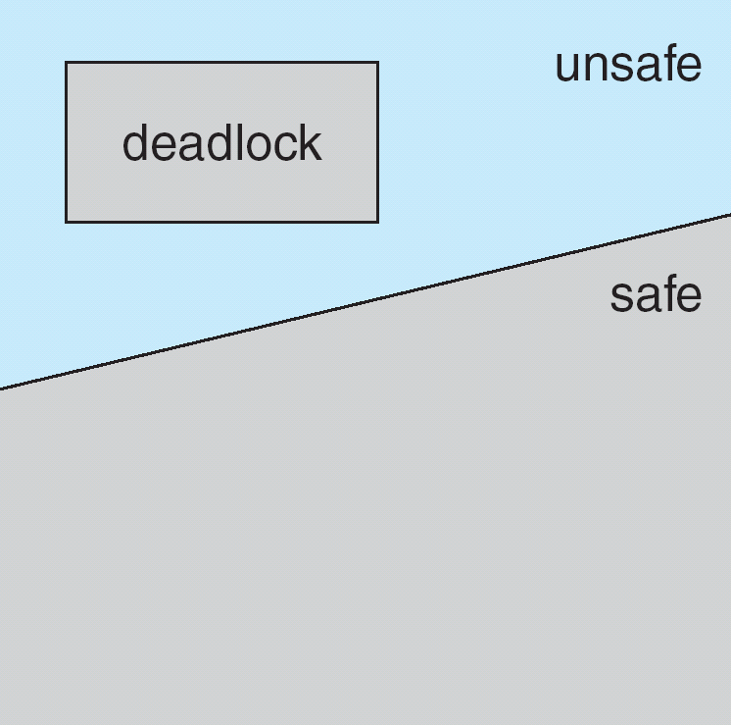
Safe, Unsafe , Deadlock State
‹#›
Notes:
‹#›

Slide 21
Avoidance Algorithms
Single instance of a resource type
Use a resource-allocation graph
Multiple instances of a resource type
Use the banker’s algorithm
‹#›
Notes:
‹#›

Slide 22
Resource-Allocation Graph Scheme
Claim edge P_{i} → R_{j} indicates that process P_{i} may request resource R_{j}; represented by a dashed line
Claim edge is converted to a request edge when a process requests a resource
Request edge is converted to an assignment edge when the resource is allocated to the process
When a resource is released by a process, assignment edge is reconverted to a claim edge
Resources must be claimed a priori in the system
‹#›
Notes:
‹#›

Slide 23
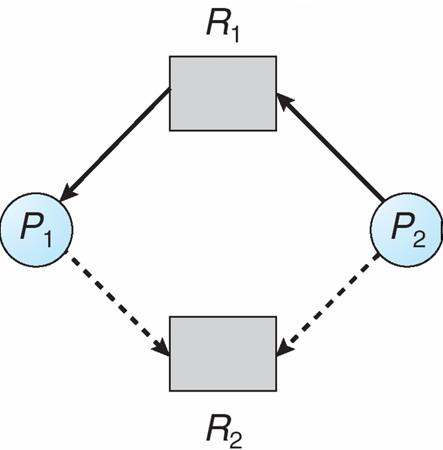
Resource-Allocation Graph
‹#›
Notes:
‹#›

Slide 24
Resource-Allocation Graph
P2 requests R2; should we allocate?
‹#›
Notes:
‹#›

Slide 25
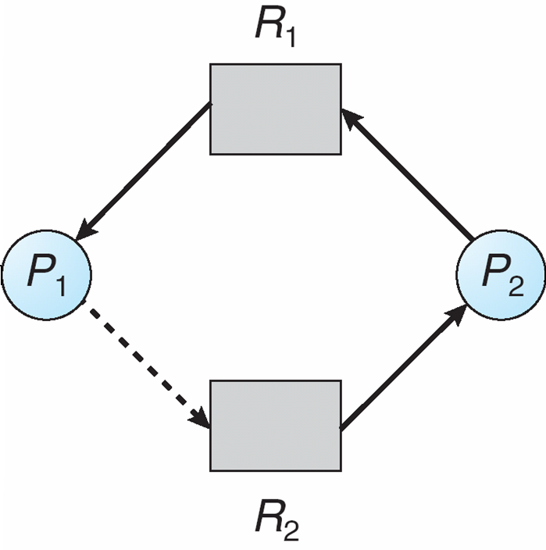
Unsafe State In Resource-Allocation Graph
‹#›
Notes:
‹#›

Slide 26
Resource-Allocation Graph Algorithm
Suppose that process P_{i} requests a resource R_{j}
The request can be granted only if converting the request edge to an assignment edge does not result in the formation of a cycle in the resource allocation graph.
‹#›
Notes:
‹#›

Slide 27
Banker’s Algorithm
Multiple instances
Each process must a priori claim maximum use
When a process requests a resource it may have to wait
When a process gets all its resources it must return them in a finite amount of time
‹#›
Notes:
‹#›

Slide 28
Simple Example
Assume a resource A (printer) has 5 instances.
There are 2 processes: P1, P2
Max demand is: 5 5
Current Allocation is: 3 0
Need is: ….. (write on the board)
Available is: …..
Is the current state safe?
Solve the problem on the board
‹#›

Slide 29
Simple Example
Assume P2 request 1 instance and it is granted. Is the new state safe?
Current Allocation will be : 3 1
Need is: ….. (write on the board)
Available is: …..
Solve the problem on the board
‹#›

Slide 30
Data Structures for the Banker’s Algorithm
Let n = number of processes, and
m = number of resources types.
Available: Vector of length m. If Available[j] == k, there are k instances of resource type R_{j} at the time deadlock avoidance algorithms is run.
Max: n x m matrix. If Max[i,j] == k, then process P_{i} may request at most k instances of resource type R_{j}
Allocation: n x m matrix. If Allocation[i,j] == k then P_{i} is currently allocated k instances of R_{j}
Need: n x m matrix. If Need[i,j] = k, then P_{i} may need k more instances of R_{j} to complete its task Need[i,j] = Max[i,j] – Allocation[i,j]
‹#›
Notes:
‹#›

Slide 31
An example system state
Available A B C
10 5 7
Existing A B C
10 5 7
Initially Available == Existing
All resources in the
system
system state at some t (may change)
Need = Max - Allocation
 | Max A B C
P0 | 7 5 3
P1 | 3 2 2
P2 | 9 0 2
P3 | 2 2 2
P4 | 4 3 3
 | Allocation A B C
P0 | 0 1 0
P1 | 2 0 0
P2 | 3 0 2
P3 | 2 1 1
P4 | 0 0 2
 | Need A B C
P0 | 7 4 3
P1 | 1 2 2
P2 | 6 0 0
P3 | 0 1 1
P4 | 4 3 1
Available A B C
3 3 2
‹#›
Notes:
‹#›

Slide 32
Notation
 | X A B C
P0 | 0 1 0
P1 | 2 0 0
P2 | 3 0 2
P3 | 2 1 1
P4 | 0 0 2
Compare two vectors:
X is a matrix.
X_{i} is the i^{th} row of the matrix: it is a vector.
For example, X₃ = [2 1 1]
Ex: compare V with X_{i}
V
X_{i}
V == X_{i} ?
V <= X_{i} ? X_{i} <= V ?
….
V A B C
3 3 2
V is a vector; V = [3 3 2]
Ex: Compare [3 3 2] with [2 2 1]
[2 2 1] <= [3 3 2]
‹#›
Notes:
‹#›

Slide 33
Safety Algorithm
1. Let Work and Finish be vectors of length m and n, respectively. Initialize:
Work = Available (initialize Work temporary vector)
Finish [i] = false for i = 0, 1, …, n-1
(Work is a temporary vector initialized to the Available (i.e., free) resources at that time when the safety check is performed)
2. Find an i such that both:
(a) Finish [i] = false
(b) Need_{i} ≤ Work
If no such i exists, go to step 4
Work = Work + Allocation_{i} Finish[i] = true go to step 2
4. If Finish [i] == true for all i, then the system state is safe; o.w. unsafe.
 | Allocation A B C
P0 | 0 1 0
P1 | 2 0 0
P2 | 3 0 2
P3 | 2 1 1
P4 | 0 0 2
 | Need A B C
P0 | 7 4 3
P1 | 1 2 2
P2 | 6 0 0
P3 | 0 1 1
P4 | 4 3 1
Available
[3 3 2]
‹#›
Notes:
‹#›

Slide 34
Resource-Request Algorithm for Process P_{i}
Request: request vector for process P_{i}. If Request_{i}[j] == k, then process P_{i} wants k instances of resource type R_{j}
Algorithm
1. If Request_{i} ≤ Need_{i} go to step 2. Otherwise, raise error condition, since process has exceeded its maximum claim
2. If Request_{i} ≤ Available, go to step 3. Otherwise P_{i} must wait, since resources are not available
‹#›
Notes:
‹#›

Slide 35
Resource-Request Algorithm for Process P_{i}
3. Pretend to allocate requested resources to P_{i} by modifying the state as follows:
Available = Available – Request_{i};
Allocation_{i} = Allocation_{i} + Request_{i};
Need_{i} = Need_{i} – Request_{i};
Run the Safety Check Algorithm:
If safe ⇒ the requested resources are allocated to P_{i}
If unsafe ⇒ The requested resources are not allocated to P_{i}.
P_{i} must wait.
The old resource-allocation state is restored.
‹#›
Notes:
‹#›

Slide 36
Example of Banker’s Algorithm
5 processes P₀ through P₄;
3 resource types: A, B, and C
Existing Resources: A (10 instances), B (5 instances), and C (7 instances)
Existing = [10, 5, 7] initially, Available = Existing.
Assume, processes indicated their maximum demand as follows:
 | Max A B C
P0 | 7 5 3
P1 | 3 2 2
P2 | 9 0 2
P3 | 2 2 2
P4 | 4 3 3
Initially, Allocation matrix will
be all zeros. Need matrix will
be equal to the Max matrix.
‹#›
Notes:
‹#›

Slide 37
Example of Banker’s Algorithm
Assume later, at an arbitrary time t, we have the following system state:
Existing = [10 5 7]
Need =
Max - Allocation
 | Max A B C
P0 | 7 5 3
P1 | 3 2 2
P2 | 9 0 2
P3 | 2 2 2
P4 | 4 3 3
 | Allocation A B C
P0 | 0 1 0
P1 | 2 0 0
P2 | 3 0 2
P3 | 2 1 1
P4 | 0 0 2
 | Need A B C
P0 | 7 4 3
P1 | 1 2 2
P2 | 6 0 0
P3 | 0 1 1
P4 | 4 3 1
Available A B C
3 3 2
Is it a safe state?
‹#›
Notes:
‹#›

Slide 38
Example of Banker’s Algorithm
 | Allocation A B C
P0 | 0 1 0
P1 | 2 0 0
P2 | 3 0 2
P3 | 2 1 1
P4 | 0 0 2
 | Need A B C
P0 | 7 4 3
P1 | 1 2 2
P2 | 6 0 0
P3 | 0 1 1
P4 | 4 3 1
Available A B C
3 3 2
Try to find a row in Need_{i} that is <= Available.
P1. run completion. Available becomes = [3 3 2] + [2 0 0] = [5 3 2]
P3. run completion. Available becomes = [5 3 2] + [2 1 1] = [7 4 3]
P4. run completion. Available becomes = [7 4 3] + [0 0 2] = [7 4 5]
P2. run completion. Available becomes = [7 4 5] + [3 0 2] = [10 4 7]
P0. run completion. Available becomes = [10 4 7] + [0 1 0] = [10 5 7]
We found a sequence of execution: P1, P3, P4, P2, P0. State is safe
‹#›
Notes:
‹#›

Slide 39
Example: P₁ requests (1,0,2)
At that time Available is [3 3 2]
First check that Request ≤ Available (that is, (1,0,2) ≤ (3,3,2) ⇒ true.
Then check the new state for safety:
 | Max A B C
P0 | 7 5 3
P1 | 3 2 2
P2 | 9 0 2
P3 | 2 2 2
P4 | 4 3 3
 | Allocation A B C
P0 | 0 1 0
P1 | 3 0 2
P2 | 3 0 2
P3 | 2 1 1
P4 | 0 0 2
 | Need A B C
P0 | 7 4 3
P1 | 0 2 0
P2 | 6 0 0
P3 | 0 1 1
P4 | 4 3 1
Available A B C
2 3 0
new state (we did not go to that state yet; we are just checking)
‹#›
Notes:
‹#›

Slide 40
Example: P₁ requests (1,0,2)
 | Allocation A B C
P0 | 0 1 0
P1 | 3 0 2
P2 | 3 0 2
P3 | 2 1 1
P4 | 0 0 2
 | Need A B C
P0 | 7 4 3
P1 | 0 2 0
P2 | 6 0 0
P3 | 0 1 1
P4 | 4 3 1
Available A B C
2 3 0
new state
Can we find a sequence?
Run P1. Available becomes = [5 3 2]
Run P3. Available becomes = [7 4 3]
Run P4. Available becomes = [7 4 5]
Run P0. Available becomes = [7 5 5]
Run P2. Available becomes = [10 5 7]
Sequence is:
P1, P3, P4, P0, P2
Yes, New State is safe.
We can grant the request.
Allocate desired resources to process P1.
‹#›
Notes:
‹#›

Slide 41
P₄ requests (3,3,0)?
 | Allocation A B C
P0 | 0 1 0
P1 | 3 0 2
P2 | 3 0 2
P3 | 2 1 1
P4 | 0 0 2
 | Need A B C
P0 | 7 4 3
P1 | 0 2 0
P2 | 6 0 0
P3 | 0 1 1
P4 | 4 3 1
Available A B C
2 3 0
Current state
If this is current state, what happens if P4 requests (3 3 0)?
There is no available resource to satisfy the request. P4 will be waited.
‹#›
Notes:
‹#›

Slide 42
P₀ requests (0,2,0)? Should we grant?
 | Allocation A B C
P0 | 0 1 0
P1 | 3 0 2
P2 | 3 0 2
P3 | 2 1 1
P4 | 0 0 2
 | Need A B C
P0 | 7 4 3
P1 | 0 2 0
P2 | 6 0 0
P3 | 0 1 1
P4 | 4 3 1
Available A B C
2 3 0
Current state
System is in this state.
P0 makes a request: [0, 2, 0]. Should we grant.
‹#›
Notes:
‹#›

Slide 43
P₀ requests (0,2,0)? Should we grant?
Assume we allocate 0,2,0 to P0. The new state will be as follows.
 | Allocation A B C
P0 | 0 3 0
P1 | 3 0 2
P2 | 3 0 2
P3 | 2 1 1
P4 | 0 0 2
 | Need A B C
P0 | 7 2 3
P1 | 0 2 0
P2 | 6 0 0
P3 | 0 1 1
P4 | 4 3 1
Available A B C
2 1 0
New state
Is it safe?
No process has a row in Need matrix that is less than or equal to Available. Therefore, the new state would be UNSAFE. Hence we should not go
to the new state. The request is not granted. P0 is waited.
‹#›
Notes:
‹#›

Slide 44
Deadlock Detection
Allow system to enter deadlock state
Detection algorithm
Recovery scheme
‹#›
Notes:
‹#›

Slide 45
Single Instance of Each Resource Type
Maintain wait-for graph
Nodes are processes
P_{i} → P_{j} if P_{i} is waiting for P_{j}
Periodically invoke an algorithm that searches for a cycle in the graph. If there is a cycle, there exists a deadlock
An algorithm to detect a cycle in a graph requires an order of n² operations, where n is the number of vertices in the graph
‹#›
Notes:
‹#›

Slide 46
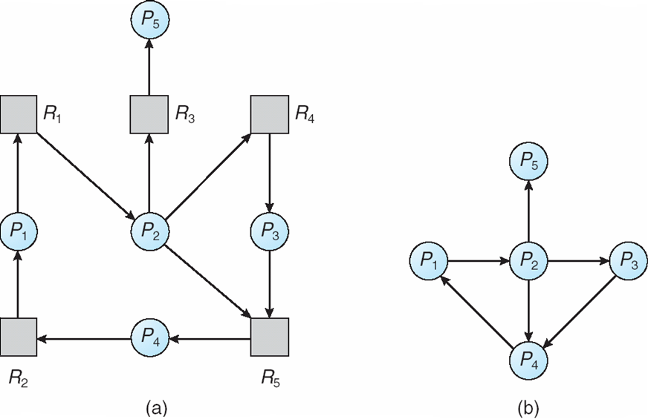
Single Instance of Each Resource Type
‹#›
Notes:
‹#›

Slide 47
Several Instances of Resource Type
Available: A vector of length m indicates the number of available resources of each type.
Allocation: An n x m matrix defines the number of resources of each type currently allocated to each process.
Request: An n x m matrix indicates the current request of each process. If Request [i_{j}] = k, then process P_{i} is requesting k more instances of resource type. R_{j}.
System state is represented by this information
‹#›
Notes:
‹#›

Slide 48
Detection Algorithm
1. Let Work and Finish be vectors of length m and n, respectively. Initialize:
(a) Work = Available
(b) For i = 1,2, …, n, if Allocation_{i} ≠ 0, then Finish[i] = false; otherwise, Finish[i] = true
2. Find an index i such that both:
(a) Finish[i] == false
(b) Request_{i} ≤ Work
If no such i exists, go to step 4
‹#›
Notes:
‹#›

Slide 49
Detection Algorithm (Cont.)
3. Work = Work + Allocation_{i} Finish[i] = true go to step 2
4. If Finish[i] == false, for some i, 1 ≤ i ≤ n, then the system is in deadlock state. Moreover, if Finish[i] == false, then P_{i} is deadlocked
‹#›
Notes:
‹#›

Slide 50
Example of Detection Algorithm
Existing A B C
7 2 6
Five processes P₀ through P₄; three resource types A (7 instances), B (2 instances), and C (6 instances)
Snapshot at time t:
Sequence <P₀, P₂, P₃, P₁, P₄> will result in Finish[i] = true for all i
 | Allocation A B C
P0 | 0 1 0
P1 | 2 0 0
P2 | 3 0 3
P3 | 2 1 1
P4 | 0 0 2
 | Request A B C
P0 | 0 0 0
P1 | 2 0 2
P2 | 0 0 0
P3 | 1 0 0
P4 | 0 0 2
Available A B C
0 0 0
‹#›
Notes:
‹#›

Slide 51
Example of Detection Algorithm
 | Allocation A B C
P0 | 0 1 0
P1 | 2 0 0
P2 | 3 0 3
P3 | 2 1 1
P4 | 0 0 2
 | Request A B C
P0 | 0 0 0
P1 | 2 0 2
P2 | 0 0 0
P3 | 1 0 0
P4 | 0 0 2
Available A B C
0 0 0
Can we find a row i in Request that can be satisfied with Available, i.e. Request_{i} <= Available?
P0 is not deadlocked at the moment. Run completion. Available becomes: [0 1 0]
Then P2 can be satisfied. Can run completion. Available becomes: [3 1 3]
Then P3 can be satisfied. Can run completion. Available becomes: [5 2 4]
Then P1 can be satisfied. Can run completion. Available becomes: [7 2 4]
Then P4 can be satisfied. Can run completion. Available becomes: [7 2 6]
‹#›
Notes:
‹#›

Slide 52
Another example
Lets assume at time t2, P₂ makes a request for an additional instance of type C. Then Request matrix becomes
Is the system deadlocked? Check it.
 | Request A B C
P0 | 0 0 0
P1 | 2 0 2
P2 | 0 0 1
P3 | 1 0 0
P4 | 0 0 2
‹#›
Notes:
‹#›

Slide 53
Check
 | Allocation A B C
P0 | 0 1 0
P1 | 2 0 0
P2 | 3 0 3
P3 | 2 1 1
P4 | 0 0 2
 | Request A B C
P0 | 0 0 0
P1 | 2 0 2
P2 | 0 0 1
P3 | 1 0 0
P4 | 0 0 2
Available A B C
0 0 0
We can run P0. Then Available becomes: [0 1 0]
Now, we can not find a row of Request that can be satisfied.
Hence all processes P1, P2, P3, and P4 have to wait in their requests. We
have a deadlock.
Processes P1, P2, P3, and P4 are deadlocked processes.
‹#›
Notes:
‹#›

Slide 54
Detection-Algorithm Usage
When, and how often, to invoke depends on:
How often a deadlock is likely to occur?
How many processes will need to be rolled back?
one for each disjoint cycle
If detection algorithm is invoked arbitrarily, there may be many cycles in the resource graph and so we would not be able to tell which of the many deadlocked processes “caused” the deadlock
‹#›
Notes:
‹#›

Slide 55
Recovery from Deadlock: Process Termination
Abort all deadlocked processes
Abort one process at a time until the deadlock cycle is eliminated
In which order should we choose to abort?
Priority of the process
How long process has computed, and how much longer to completion
Resources the process has used
Resources process needs to complete
How many processes will need to be terminated
Is process interactive or batch?
‹#›
Notes:
‹#›

Slide 56
Recovery from Deadlock: Resource Preemption
Selecting a victim – minimize cost
Rollback – return to some safe state, restart process for that state
Starvation – same process may always be picked as victim, include number of rollback in cost factor
‹#›
Notes:
‹#›

Slide 57
References
The slides here are adapted/modified from the textbook and its slides: Operating System Concepts, Silberschatz et al., 7th & 8th editions, Wiley.
REFERENCES
Operating System Concepts, 7th and 8th editions, Silberschatz et al. Wiley.
Modern Operating Systems, Andrew S. Tanenbaum, 3rd edition, 2009.
‹#›
Notes:
‹#›

